Slide 1
Testing Web Application Functionality
Website: https://www.onlineshopdemo.co.uk/
By
Akhil Janapatla

Slide 2
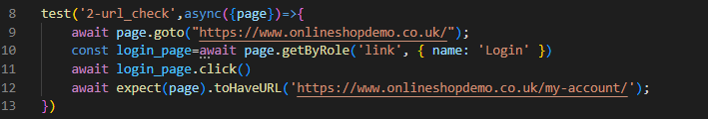




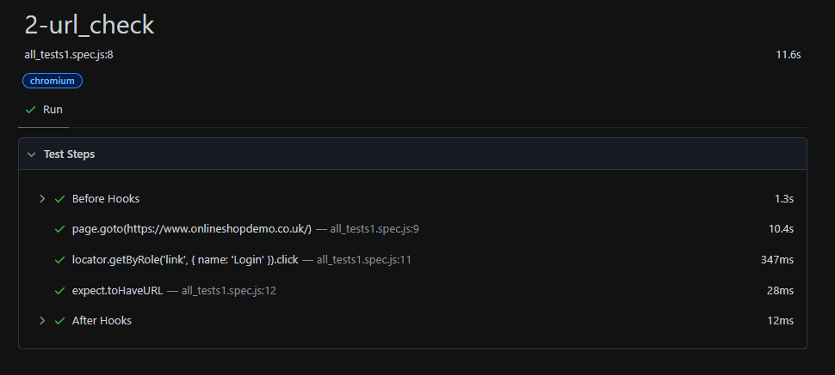
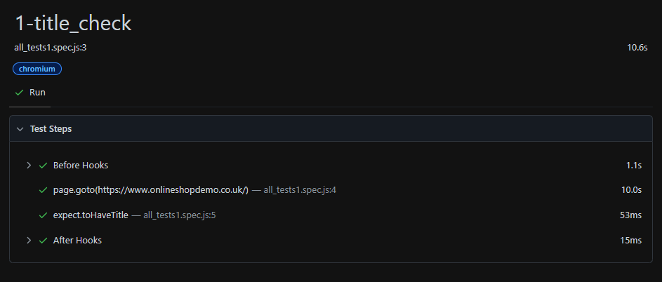
Test Case - 1: title_check
Description: Go to https://www.onlineshopdemo.co.uk/ and Verifying the page title of the home page.
Test Case - 2: url_check
Description: Validating URL of the webpage after clicking the 'Login' link.

Slide 3
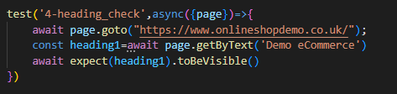
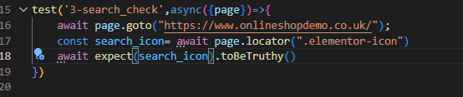


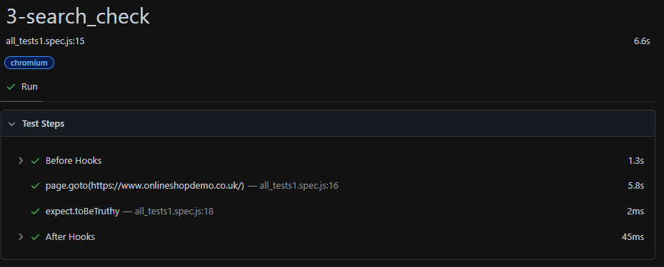
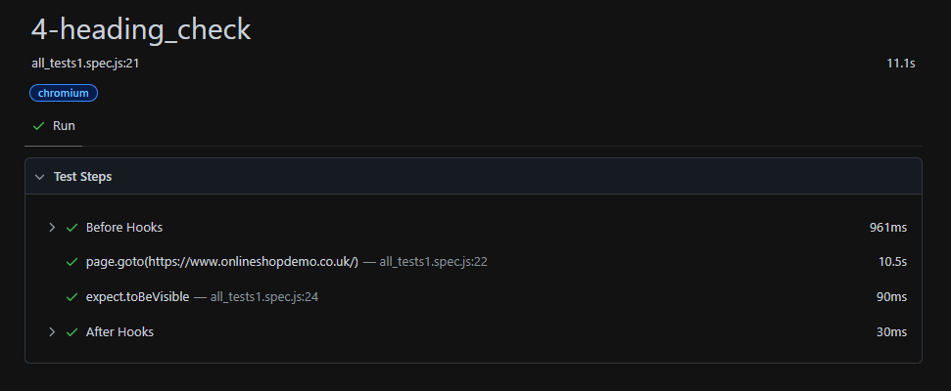
Test Case: search_check
Description: Check for the presence of the search icon and validating the page if it has search icon
Test Case: heading_check
Description: Validate visibility of the heading (Demo eCommerce) in the webpage.

Slide 4
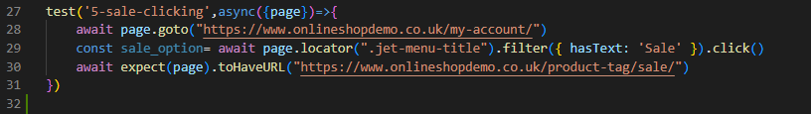

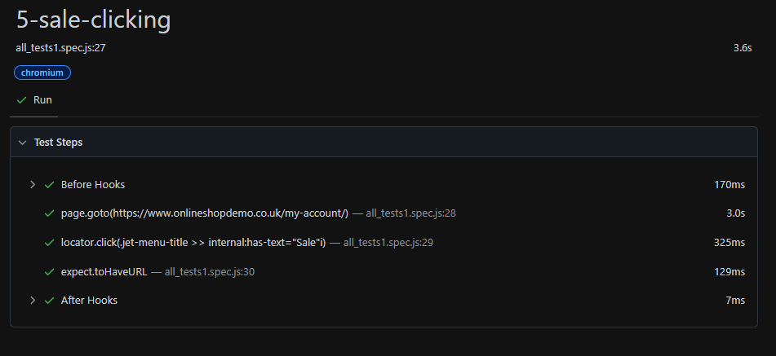
Test Case: sale URL check
Description: Verifying navigation to the 'Sale’ URL webpage.

Slide 5
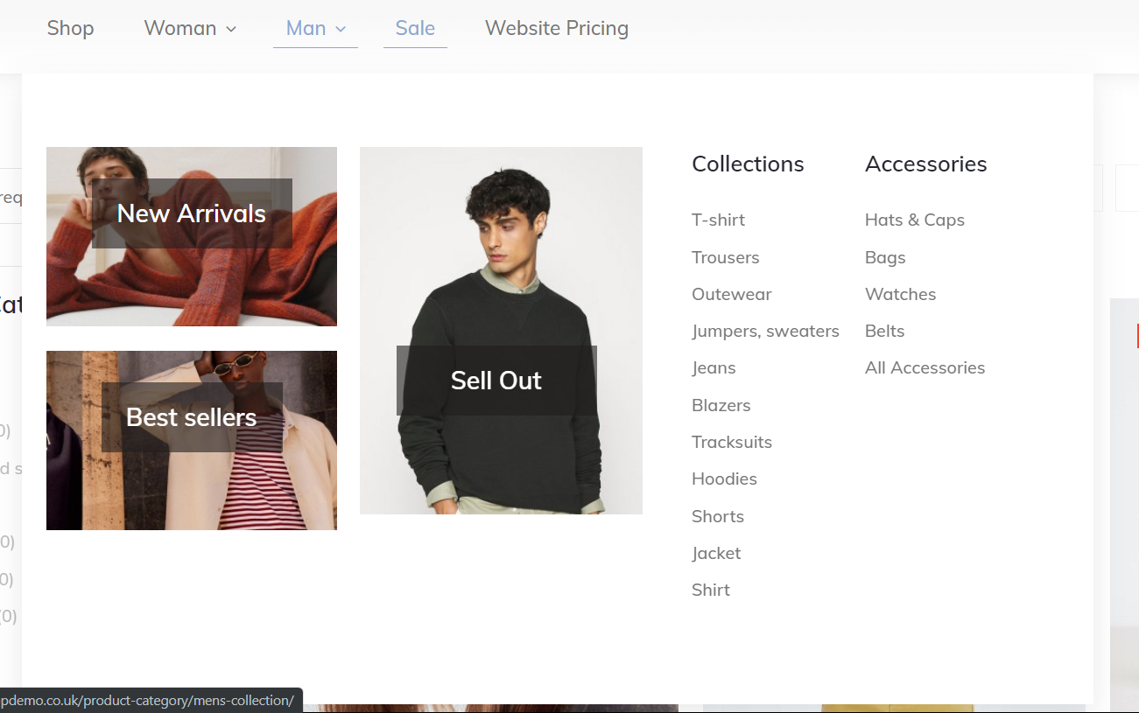
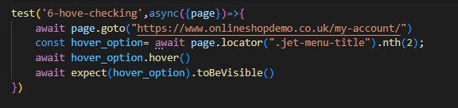
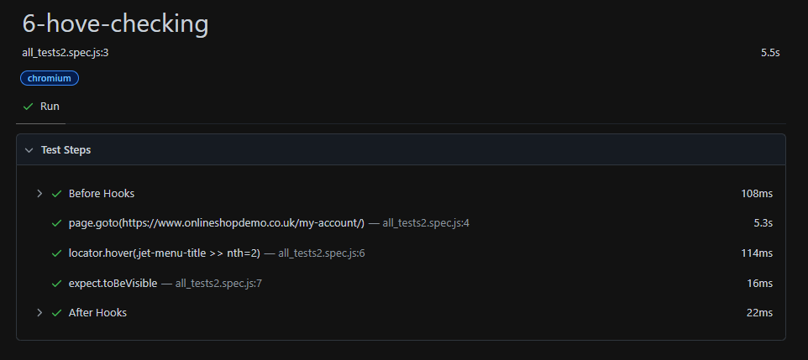
Test Case: Hover functionality check
Description: checking if hover functionality is Valid or not

Slide 6
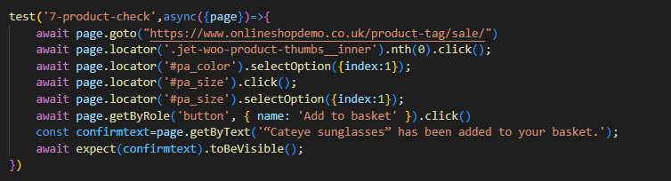
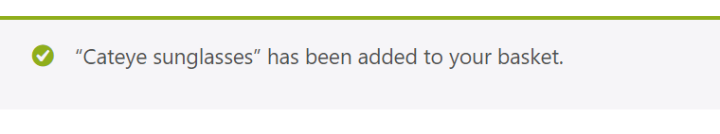
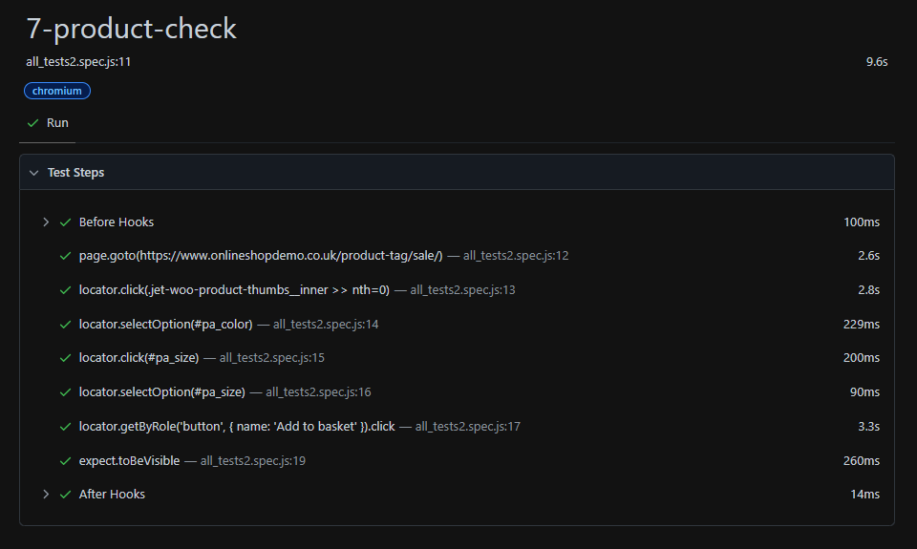
Test Case: Add to cart product Description: Add a product to the basket and verify the confirmation message.

Slide 7
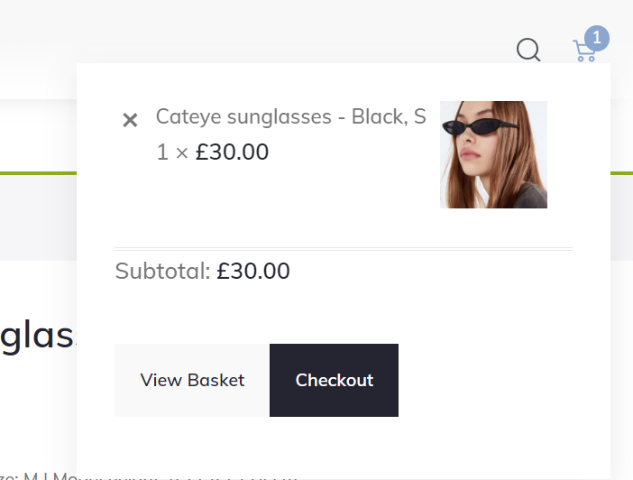
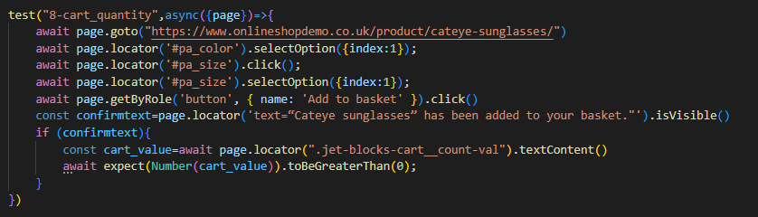
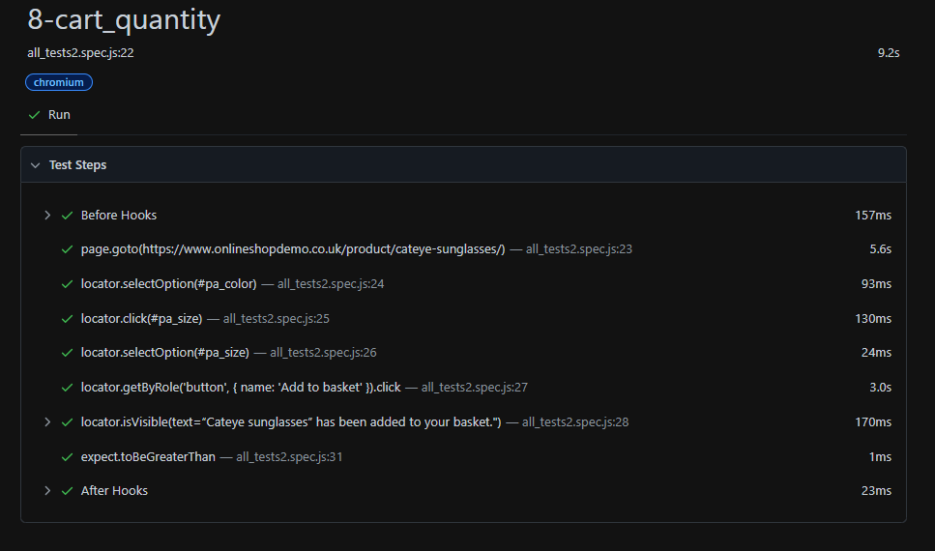
Test Case: Cart quantity Description: Add a product to the basket and verify the confirmation message and Check the cart quantity after adding a product to the cart.

Slide 8
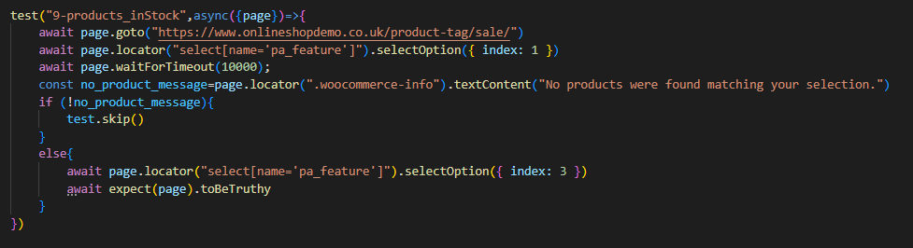
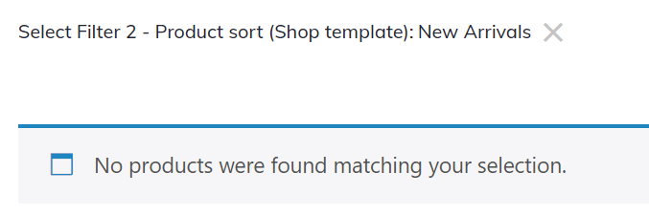
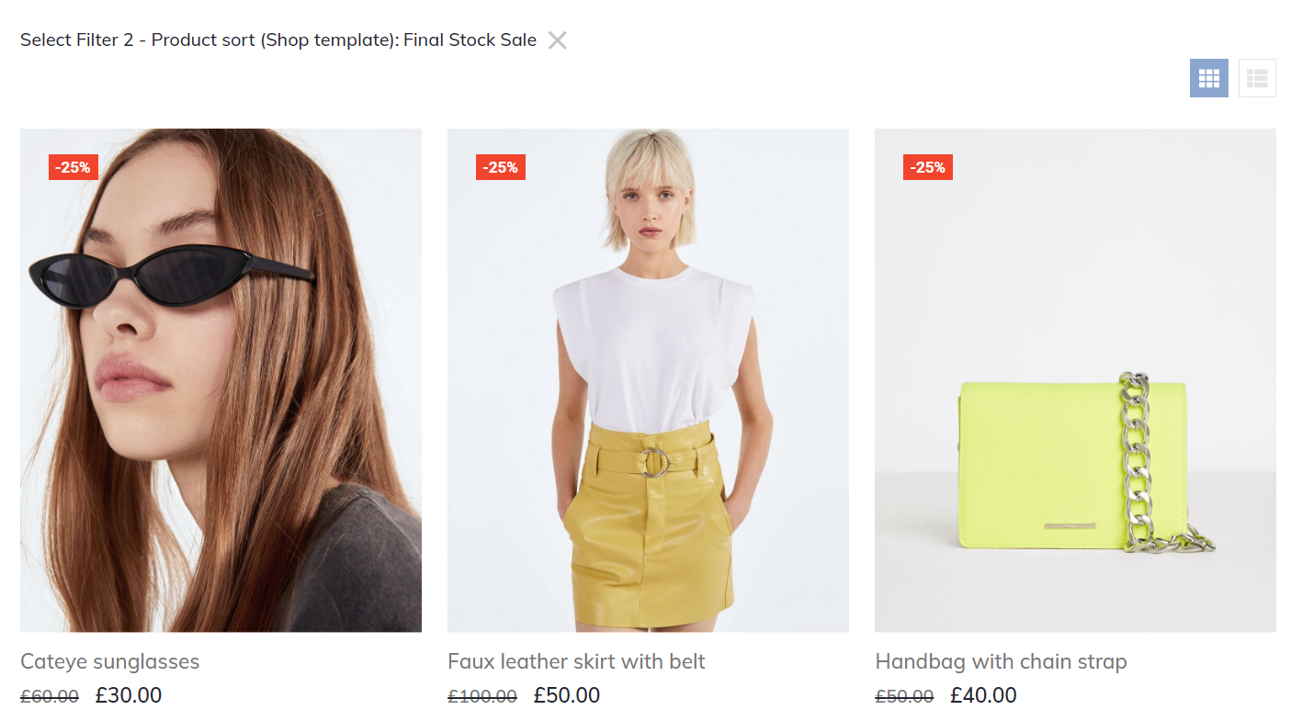
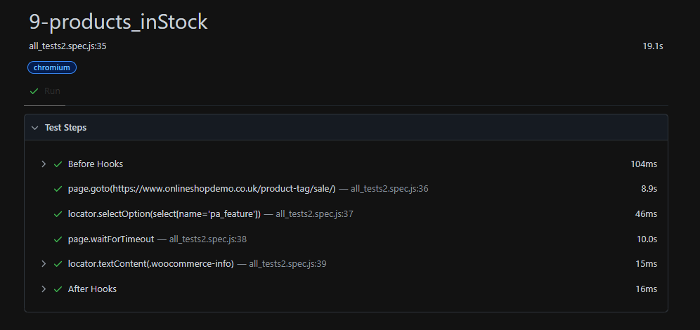
Test Cases: Applying filters Description: applying filters if no results are found. Select next filter and find the products

Slide 9
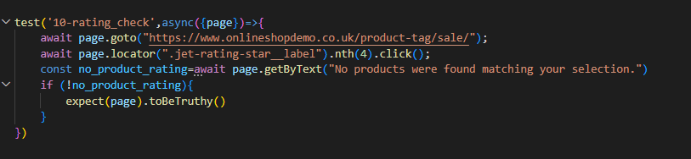

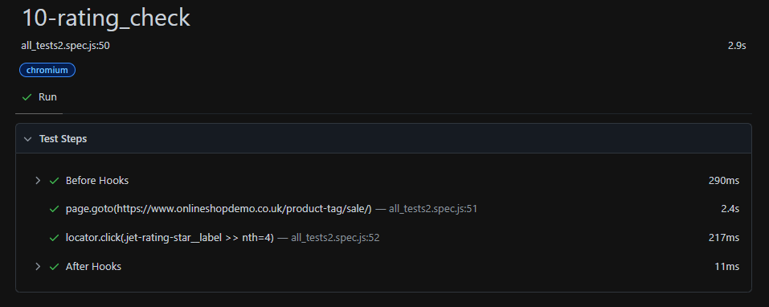
Test Case: Rating_check
Description: Check product rating and handle the product results.

Slide 10
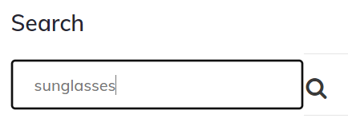
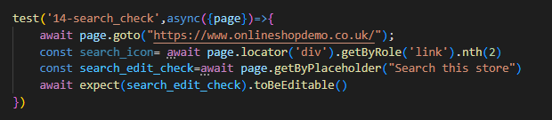
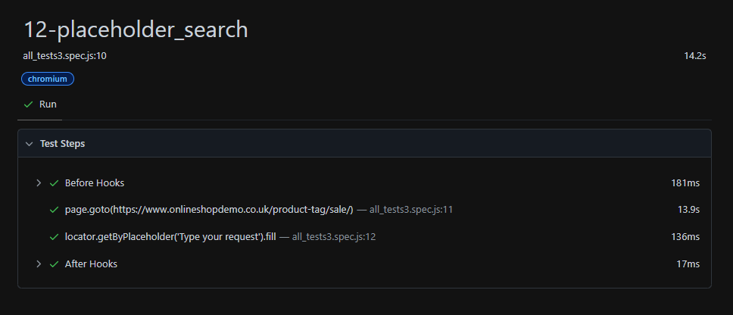
Test Case: Editable search bar check Description: Validating if search bar is editable or not

Slide 11
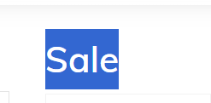
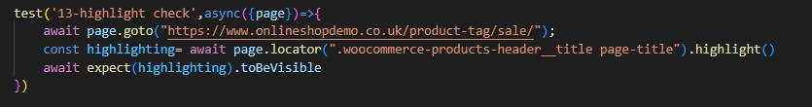
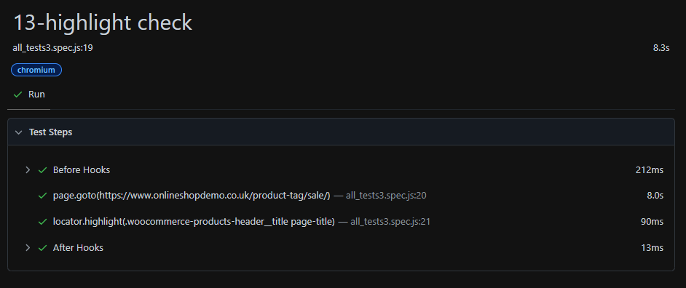
Test Case: Highlighting the selected locator Description: Validating if the locator is highlighting or not

Slide 12
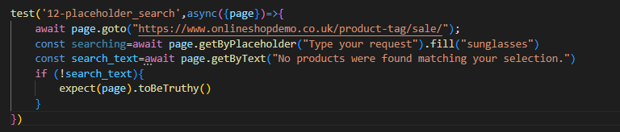
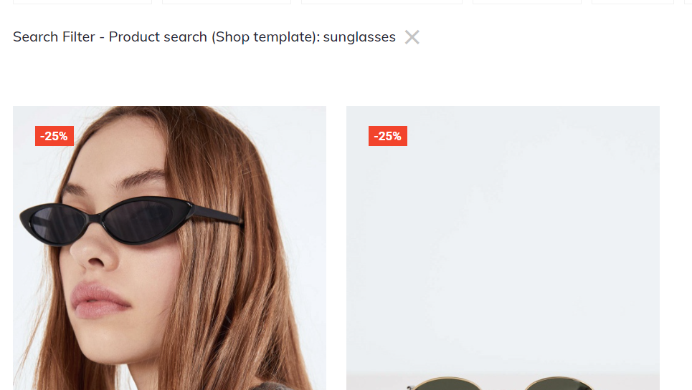
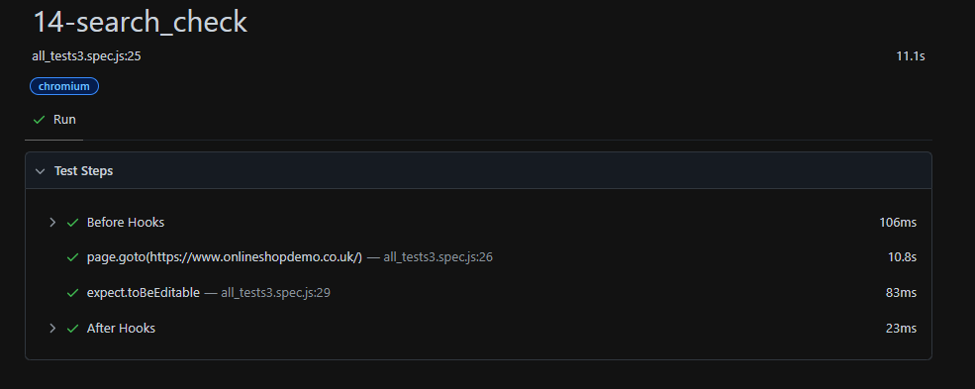
Test Case: search for results Description: typing product name and produce the results.

Slide 13
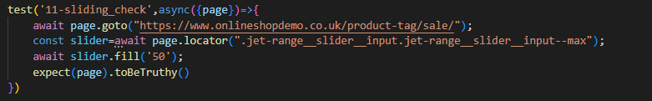

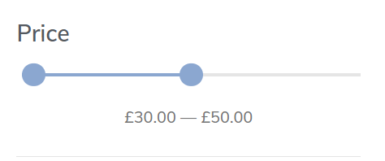
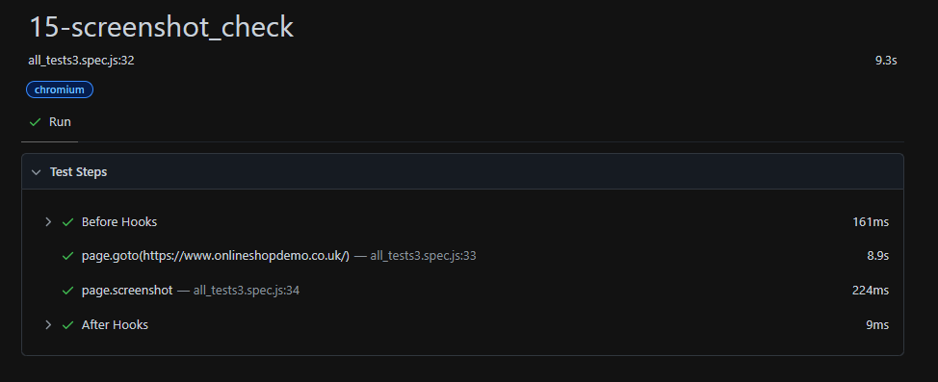
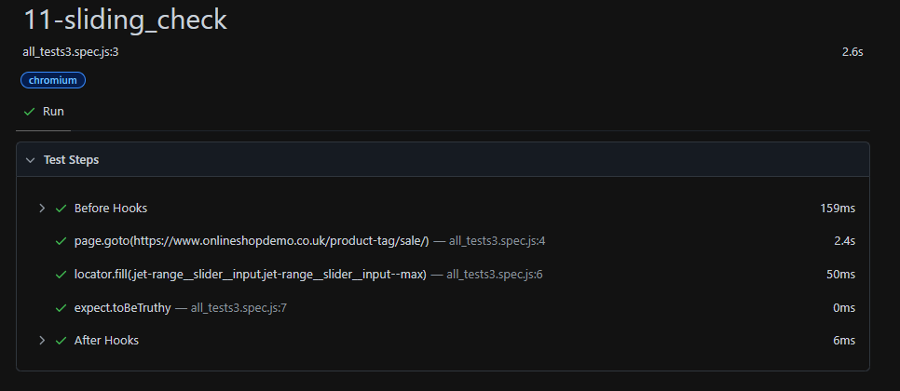
Test Case: Price range filter check Description: checks if the sliding filter works and produce the products that available Test Case: 15-screenshot_check Description: Capture a screenshot of the webpage.

Slide 14
Challenges faced
Flaky Tests: one of the tests was inconsistent, passing sometimes and failing other times.
Solution: Implemented retries to minimize the impact of these flaky
tests.
Dealing with long page loading times, which affected test execution
failing.
Solution: Applied test timeout from default to 60000ms

Slide 15
Future scope
Comprehensive Reporting: Expand reporting capabilities to include more detailed analytics and visualizations for better insights.
Scalability: Plan for scaling the test cases to handle larger, more complex applications as the project grows.
Optimize Page Load Times: Implementation to reduce page loading times, making the tests faster and more efficient.
Performance Testing: Assess the performance of the webpage under heavy load and optimize for faster load times.

Slide 16
Conclusion
This test cases was developed to ensure the core functionality and reliability of our web application. We focused on key areas like UI elements, interactions, and overall functionality of the webpage. The test cases have successfully passed, proving effective in validating the user experience.

Slide 17
Thank you

